Slide 1
Release Testing & User Testing – Ensuring Software Readiness
Testing Beyond Development: From Requirements to User Satisfaction

Slide 2
What is Release Testing?
📝 Concept:
✅ Release Testing ensures the software meets business & technical requirements before it is released to customers. ✅ Conducted in a real-world environment, different from development testing. ✅ Focuses on functionality, performance, and security before deployment.

Slide 3
Release Testing: Requirements-Based Testing
📝 Concept:
✔ Ensures the software meets all specified requirements in the Software Requirements Specification (SRS). ✔ Every feature is tested against the documented business needs.
💡 Example:
📌 If the requirement document states that a banking app should allow users to transfer money: 🔹 The test will verify if money transfer works as expected ✅. 🔹 If it fails (e.g., incorrect balance update), the software cannot be released ❌.
✅ Best Practice: Traceability Matrix (mapping each requirement to a test case).

Slide 4
Release Testing: Scenario Testing
📝 Concept:
✔ Simulates real-world use cases to check how the system performs in different conditions. ✔ Helps find issues not covered in unit or functional testing.
💡 Example:
📌 Testing an e-commerce website: ✔ A user adds items to the cart, removes them, applies a coupon, and completes the checkout. ✔ This test ensures the shopping experience is smooth and error-free.
✅ Best Practice: Define edge cases, such as: 🔹 What happens if a user tries to purchase an out-of-stock item? 🔹 What happens if payment fails?

Slide 5
Release Testing: Performance Testing
📝 Concept:
✔ Ensures software runs smoothly under expected and extreme conditions. ✔ Includes speed, scalability, and stability testing.
🔹 Types of Performance Testing:
1️⃣ Load Testing → How the system performs under normal user traffic. 2️⃣ Stress Testing → What happens under extreme load (e.g., Black Friday sales). 3️⃣ Scalability Testing → How the system handles growing users over time.
💡 Example:
📌 Netflix Performance Testing ✅ Ensures millions of users can stream videos without buffering. ✅ Tests how the system reacts if suddenly 10x more users try to stream at the same time.
✅ Best Practice: Use tools like JMeter or LoadRunner.

Slide 6
What is User Testing?
📝 Concept:
✔ User Testing ensures the software is tested by real users before the official launch. ✔ Checks usability, experience, and customer satisfaction. ✔ Focuses on real-world feedback.

Slide 7
User Testing: Alpha Testing
📝 Concept:
✔ First phase of User Testing → Conducted internally by the QA team & developers. ✔ Ensures basic functionality is stable before external users test it.
💡 Example:
📌 Microsoft Office Alpha Testing ✅ Microsoft engineers test new features before public beta release.
✅ Best Practice: Test the core features first, then refine UI/UX based on feedback.

Slide 8
User Testing: Beta Testing
📝 Concept:
✔ Second phase of User Testing → Conducted by real external users. ✔ Tests how software performs in real-world conditions. ✔ Helps find bugs that developers may not notice.
💡 Example:
📌 WhatsApp Beta Program ✅ New features like "Dark Mode" were tested by beta users before full release.
✅ Best Practice: Collect feedback using surveys & crash reports.

Slide 9
User Testing: Acceptance Testing
📝 Concept:
Final phase of testing → Determines if the software meets business & customer expectations.
User acceptance testing is used to determine whether the product is working for the user correctly.
Specific requirements which are quite often used by the customers are primarily picked for testing purposes. This is also termed as End-User Testing.
💡 Example:
📌 Government Tax System Deployment ✅ The system must pass acceptance testing before going live to process tax returns.
✅ Best Practice: Create a User Acceptance Testing (UAT) checklist.

Slide 10
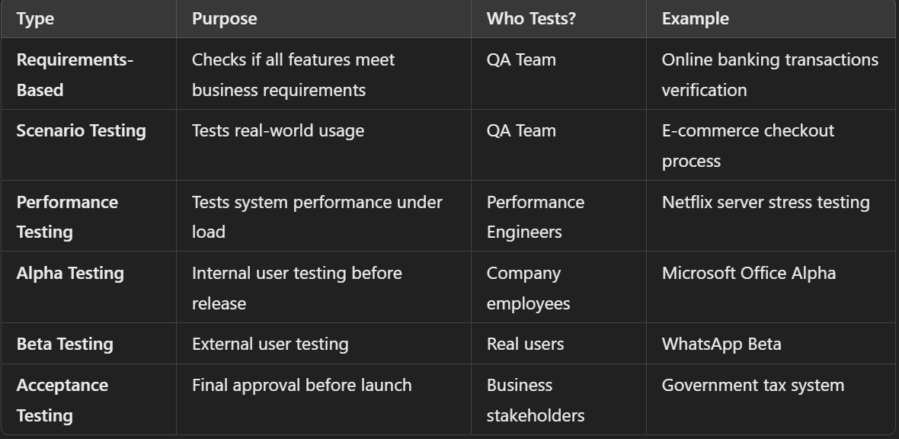

Slide 11
What is a Test Case Development Strategy?
📝 Concept:
✅ A test case development strategy defines how we design effective test cases to detect defects early. ✅ It helps ensure software reliability, efficiency, and accuracy.

Slide 12
Test Case Development Strategy:Boundary Value Analysis (BVA)
📝 Concept:
✔ BVA is a technique used to test the boundaries of input ranges where errors are most likely to occur. ✔ Instead of testing random values, we test minimum, maximum, just below, just above, and valid boundary values.
💡 Example (Numerical Calculation):
📌 A banking application allows users to withdraw money between $100 and $5000. 🔹 Test values at boundaries: ✅ Valid Cases: {100, 5000} (Min & Max values) ✅ Just Outside: {99, 5001} (Should Fail) ✅ Just Inside: {101, 4999} (Should Pass)

Slide 13
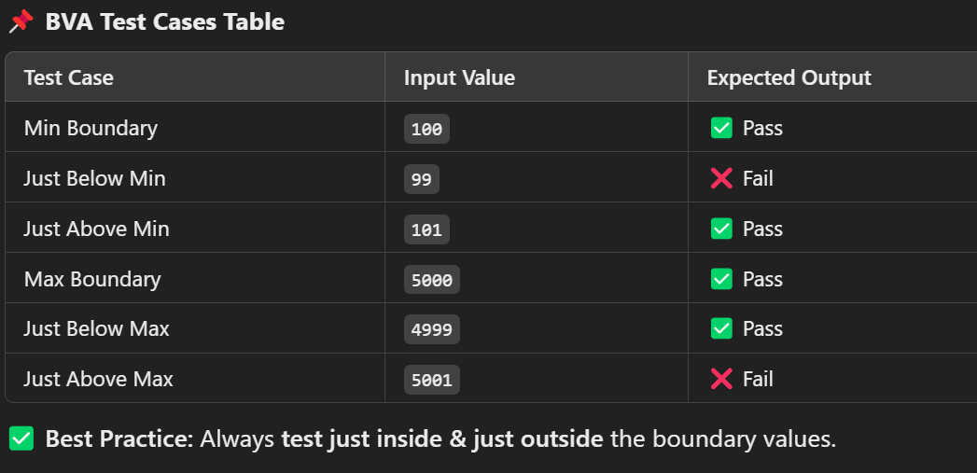
Test Case Development Strategy:Boundary Value Analysis (BVA)..

Slide 14
Test Case Development Strategy:Equivalence Partitioning
📝 Concept:
✔ Divides input data into partitions (groups) where all values behave the same. ✔ Instead of testing every possible value, we test one representative value from each partition.
💡 Example (Numerical Calculation):
📌 A university grading system assigns grades based on scores: 🔹 0-39 → Fail, 40-59 → Average, 60-79 → Good, 80-100 → Excellent.

Slide 15
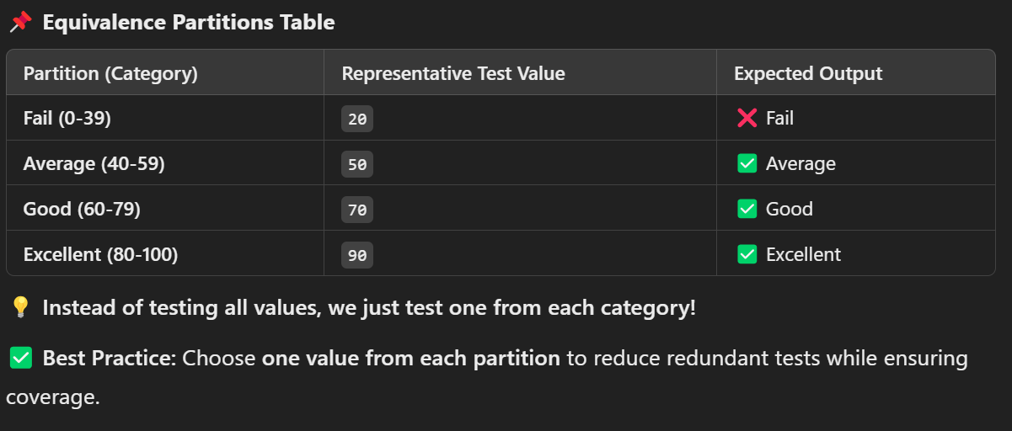
Test Case Development Strategy:Equivalence Partitioning..

Slide 16
Test Case Development Strategy: Basis Path Testing
📝 Concept: White-Box Testing
✔ White-Box Testing is a testing technique that examines the internal structure (code) of an application. ✔ The tester has full visibility into the program's logic, flow, and internal workings. ✔ Also known as Glass Box Testing, Clear Box Testing, or Structural Testing.

Slide 17
Test Case Development Strategy: Basis Path Testing..
📝 Concept: White-Box Testing
🔹 Key Characteristics of White-Box Testing
✅ Focuses on the Code → Tests logic, conditions, and branches. ✅ Requires Programming Knowledge → Testers need to understand the code. ✅ Common Techniques: 1️⃣ Basis Path Testing (control flow testing) 2️⃣ Loop Testing (verifies loops for errors) 3️⃣ Condition & Branch Testing (tests all decision points)

Slide 18
Test Case Development Strategy: Basis Path Testing..
📝 Concept:
✔ A White-Box Testing technique that ensures all possible execution paths in a program are tested. ✔ It is based on graph theory and uses a Control Flow Graph (CFG) to determine the minimum number of test cases needed.

Slide 19
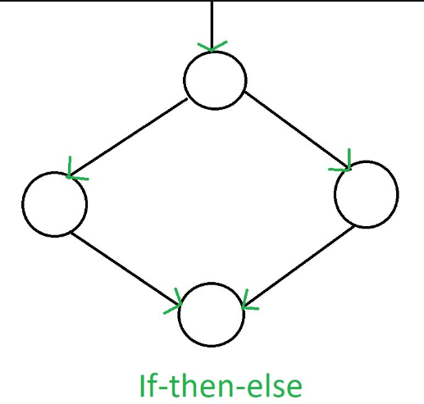
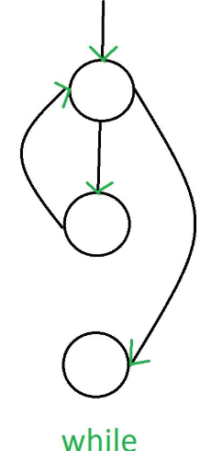
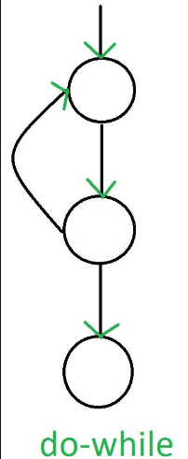
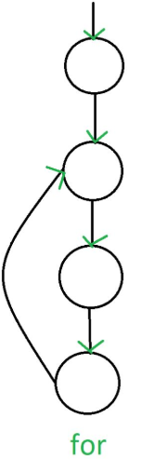
Test Case Development Strategy: Basis Path Testing..
Control Flow Graph:
CFG" stands for "Control Flow Graph," which is a graphical representation of the possible execution paths within a program.
General Control Flow Graphs

Slide 20
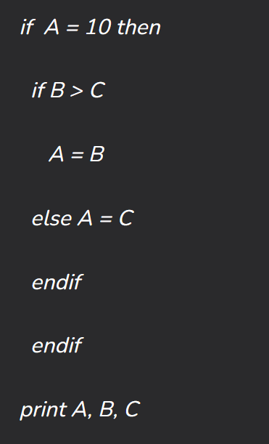
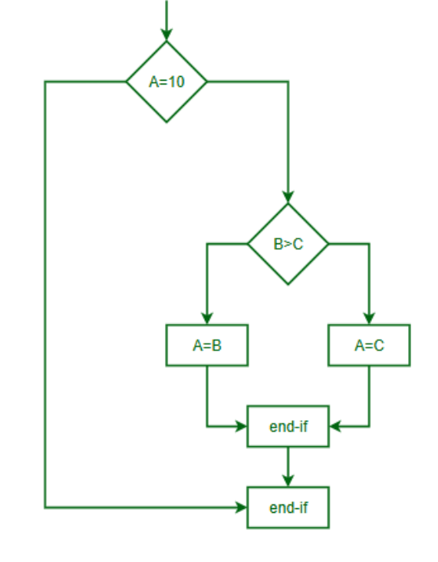
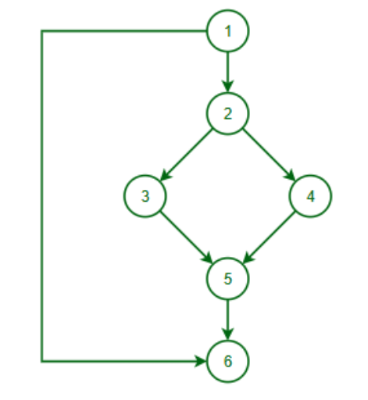
CFG Practice..

Slide 21
What is Cyclomatic Complexity?
The cyclomatic complexity of a code section is the quantitative measure of the number of linearly independent paths in it.
It is a software metric used to indicate the complexity of a program.
It is computed using the control flow graph of the program.
Mathematically, cyclomatic complexity M would be defined as,
M = E – N + 2P
Where,
E = the number of edges in the control flow graph N = the number of nodes in the control flow graph P = the number of connected components

Slide 22
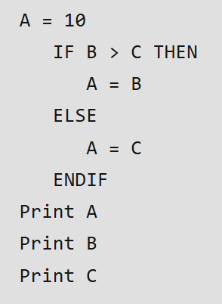
Cyclomatic Complexity ..

Slide 23
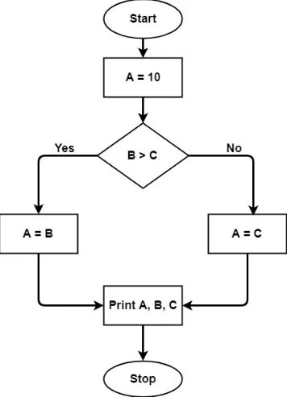
Cyclomatic Complexity ..
The graph shows seven shapes(nodes), and seven lines(edges), hence cyclomatic complexity is 7-7+2 = 2.

Slide 24
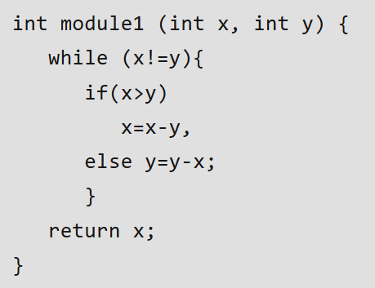
Cyclomatic Complexity ..

Slide 25
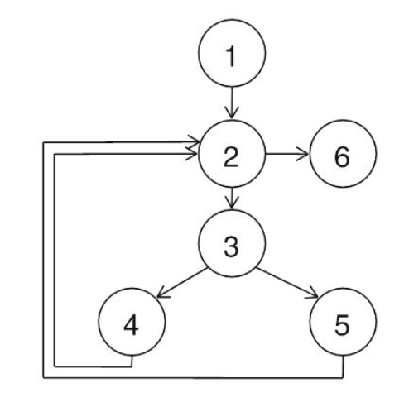
Cyclomatic Complexity ..
cyclomatic complexity is 7-6+2 = 3

Slide 26
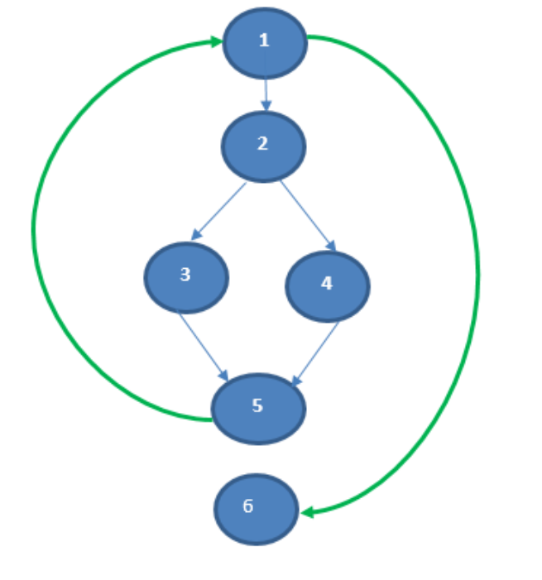
Cyclomatic Complexity ..
cyclomatic complexity is 7-6+2 = 3

Slide 27
Test Case Development Strategy: Basis Path Testing..
🔹 1️⃣ Draw the Control Flow Graph (CFG)
Represent the program flow using nodes (operations) and edges (connections between operations).
🔹 2️⃣ Calculate Cyclomatic Complexity (V(G))
Cyclomatic Complexity tells us how many independent paths exist in the code.
Formula: V(G)=E−N+2P, Where:
E = Number of edges (connections between nodes)
N = Number of nodes (decisions/operations)
P = Number of connected components (usually 1 for a single program flow)
🔹 3️⃣ Design Test Cases
Create test cases to cover each independent path in the flowchart.

Slide 28
Test Case Development Strategy: Control Structure Testing
📝 Concept:
✔ Focuses on testing control structures like loops, conditions, and branches. ✔ Includes Decision Coverage, Condition Coverage, and Loop Testing.
🔹 Types of Control Structure Testing
1️⃣ Decision Coverage: Ensures all possible decision outcomes (True/False) are tested. 2️⃣ Condition Coverage: Tests each condition within a decision separately. 3️⃣ Loop Testing: Tests loop execution:
Zero iterations (Skip loop)
One iteration
Multiple iterations
Boundary conditions

Slide 29
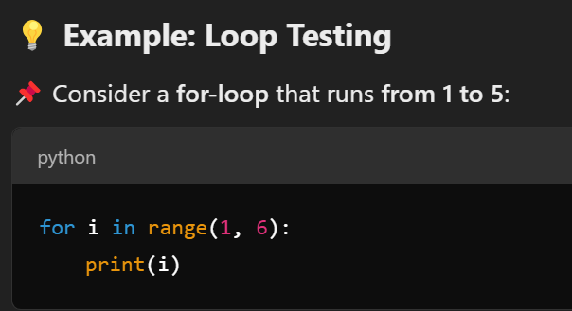
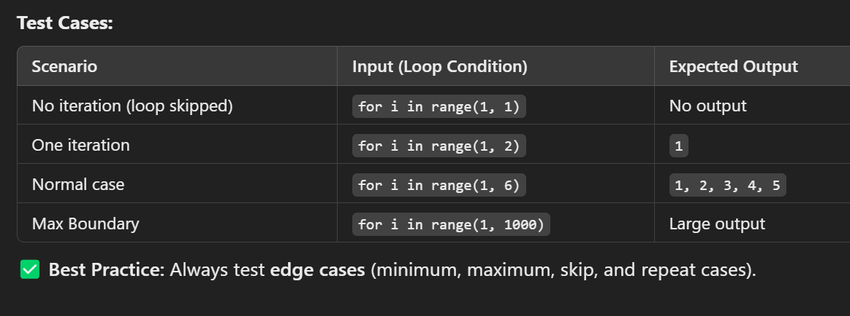
Test Case Development Strategy: Control Structure Testing..

Slide 30
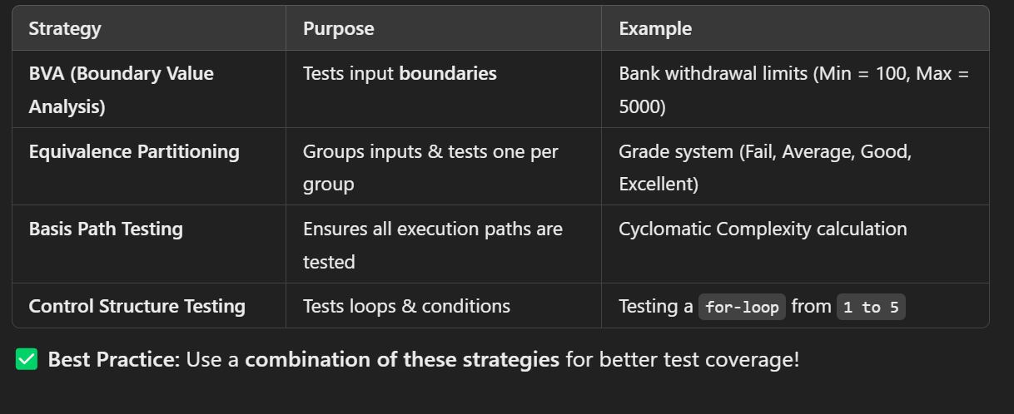
Test Case Development Strategy

Slide 31
Software Changes and Evolution
📝 Concept:
✔ Software is never static – It constantly evolves to meet new requirements, fix bugs, and adapt to technology. ✔ Evolution refers to the process of modifying software over time. ✔ Coined by Manny Lehman’s Laws of Software Evolution.

Slide 32
Software Changes and Evolution: Types of Software Changes
🔹 Four Types of Software Changes
1️⃣ Corrective Changes (Bug Fixes) → Fixes errors & defects. 2️⃣ Adaptive Changes (Technology Updates) → Software evolves to support new platforms or OS. 3️⃣ Perfective Changes (Performance & Features) → Enhances performance or adds new user-requested features. 4️⃣ Preventive Changes (Future Proofing) → Improves code quality, security, and maintainability to prevent future issues.

Slide 33
Software Changes and Evolution: Example : Evolution of Web Browsers
📌 Google Chrome Evolution 🔹 2008: Simple browser with basic UI. 🔹 2010: Extensions & Sync added. 🔹 2015: Performance optimizations. 🔹 2020+: AI-based tab grouping & privacy improvements.
✅ Shows how software evolves to adapt to user needs, technology, and competition.

Slide 34
What is Software Maintenance?
📝 Concept:
✔ Software Maintenance is the process of modifying software after deployment to fix issues, improve functionality, or adapt to new needs. ✔ Over 70% of software costs come from maintenance, not development!
✅ Why Maintenance is Important? 🔹 Fixes bugs 🐞 🔹 Enhances performance 🚀 🔹 Ensures security updates 🔐 🔹 Adapts to new environments 💡

Slide 35
What is Software Maintenance?
📝 Concept:
✔ Software Maintenance is the process of modifying software after deployment to fix issues, improve functionality, or adapt to new needs. ✔ Over 70% of software costs come from maintenance, not development!
✅ Why Maintenance is Important? 🔹 Fixes bugs 🐞 🔹 Enhances performance 🚀 🔹 Ensures security updates 🔐 🔹 Adapts to new environments 💡

Slide 36
Software Reengineering
📝 Concept:
✔ Reengineering means redesigning and improving existing software to increase efficiency, maintainability, and scalability. ✔ Helps modernize outdated systems instead of creating new ones from scratch.
📌 Example: Windows XP → Windows 10
🔹 Windows XP (2001): Outdated, slow, security vulnerabilities. 🔹 Windows 10 (2015): Same core features, but improved UI, security, and performance through reengineering.
✅ Key Benefits of Reengineering: 🔹 Reduces Maintenance Costs 🔹 Extends Software Life 🔹 Improves Performance

